Slide 1

Comprehensive Parking Management System
Enhancing Efficiency, Safety, and Security

Slide 2
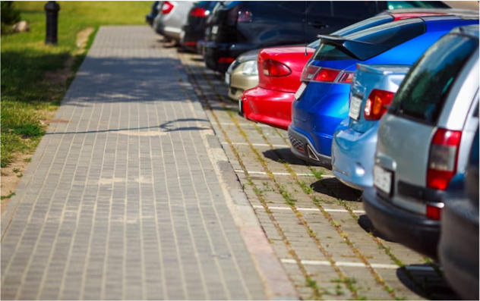
Introduction
"Comprehensive Parking Lot Management System," a state-of-the-art programme intended to completely change how we think about parking lots. Assuring effectiveness, safety, and security in parking lots is frequently not possible with traditional parking management. We will discuss in this presentation how an all-inclusive solution may greatly increase safety and security in addition to improving parking operations' efficiency. We shall examine its main goals, characteristics, and the enormous benefits it offers managers and parking lot customers.

Slide 3

Key Objectives
List the key objectives of the system
:Car counting.
Parking space availability.
Crash detection.
Car plate recognition.

Slide 4
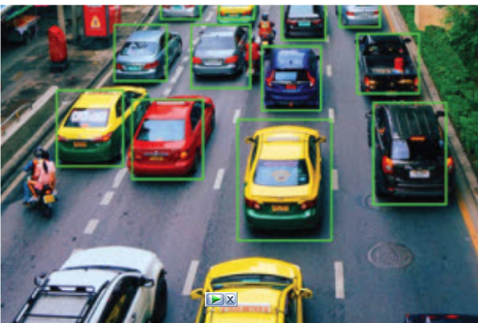
Car counting
Precise car counting is crucial in parking lots to space utilisation, boost customer satisfaction, optimise traffic control, guarantee security and safety, and provide revenue assurance. By lowering fuel use and emissions, it promotes data-driven decision-making and advances environmental sustainability.

Slide 5
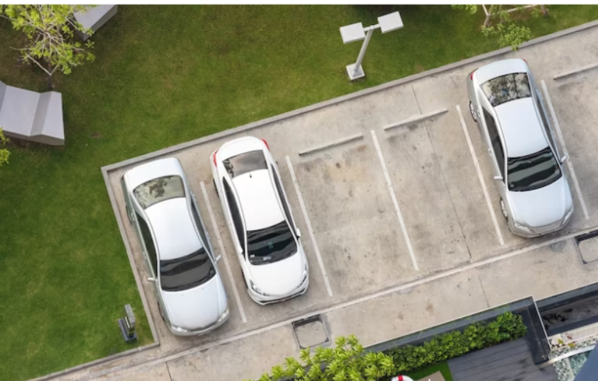
Parking space availability.
When discussing parking lot management, "space availability" refers to the current data regarding available spots inside a parking structure.For users to have a smooth and convenient experience, this information is necessary. Drivers can find and reserve a spot more quickly when they are aware of the availability of parking spaces, which cuts down on search time and traffic. It makes parking
more effective and stress-free by increasing user happiness, decreasing traffic in the parking lot, and displaying information through visual cues or an intuitive interface.

Slide 6
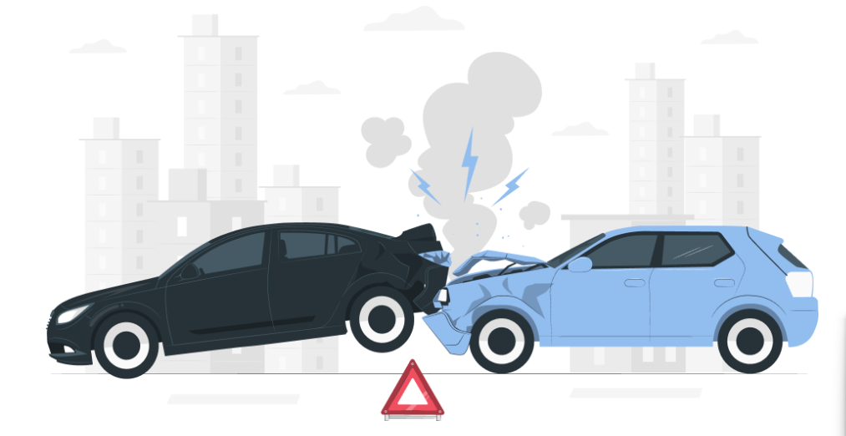
Crash detection.
When it comes to parking lot management, crash detection is a safety and security system that uses technology—such as sensors and surveillance cameras—to quickly detect and notify the authorities of any crashes or accidents that take place within the parking space. Crash detection is an essential safety and security component that helps to ensure everyone's overall safety and peace of mind by using technology to quickly identify and address accidents in parking lots.

Slide 7
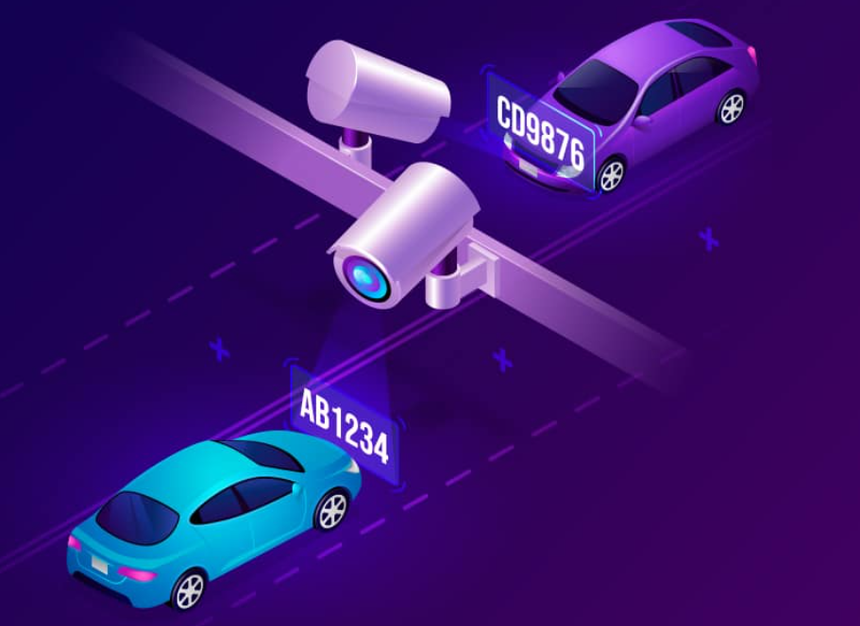
Car plate recognition
Car plate recognition, also known as Licence Plate Recognition (LPR), is a system that automatically reads and captures the alphanumeric letters on car licence plates using cameras and software. It can be used for a number of purposes in access control, security, parking management, and law enforcement. The system takes pictures of plates, splits and processes the characters, and outputs text that is readable by computers. It is employed to control access to restricted locations, improve security, support law enforcement, and automate entrance and exit in parking facilities. LPR systems' accuracy is influenced by various factors, including illumination and image quality. Because licence plates might contain personal information, privacy concerns are crucial.

Slide 8
CONCLUSION
To put it briefly, the AI-Based Comprehensive Parking Management System is a state-of-the-art tool that revolutionises parking facility management. By utilising cutting-edge technology including vehicle counting, space availability monitoring, parking infraction detection, crash detection, and licence plate recognition, it provides a comprehensive approach to parking lot management.
This system increases traffic flow within parking lots, optimises the use of parking spots, and improves user experience by giving users access to real-time information about available spaces. By quickly identifying and responding to collisions and granting access control via licence plate recognition, it also enhances safety and security.
This system is an excellent example of how artificial intelligence and cutting-edge technology can make our cities safer, smarter, and more convenient for all people in a world where effective urban planning and safety are crucial. It offers advantages to operators as well as users, changing the game in contemporary parking administration.

Slide 9
Thanks!

